Slide 1
Natural language process
Lecture 6 – topic modeling - dr. zhijiang chen
Notes:
we have explored a lot of ways to build
vector representations for words or for some pieces of text.
This lesson is about topic modeling.
Topic modeling is an alternative way to
build vector representations for your document collections

Slide 2
Topic modeling
A way to navigate through text collections
Notes:
we have explored a lot of ways to build
vector representations for words or for some pieces of text.
This lesson is about topic modeling.
Topic modeling is an alternative way to
build vector representations for your document collections

Slide 3
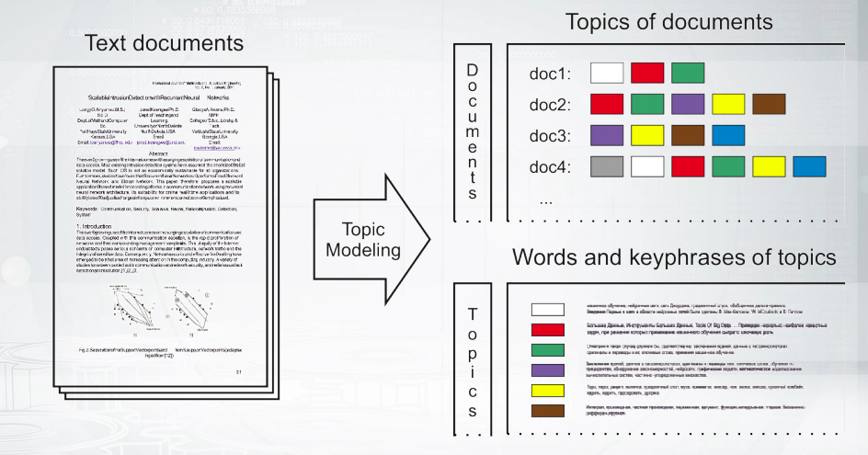
From texts to topics
Notes:
So, let us start with a brief introduction to the task.
You are given a text collection and you want to build some hidden representation.
So, you want to say that okay there are some topics here and
every document is described with those topics that are discussed in this document.
Now, what is the topic?
Well you can imagine that you can describe a topic with some words.
For example, such topic as weather is described with sky, rain, sun,
and something like this and such topics such as mathematics is described with
some mathematical terms and probably they do not even overlap at all.
So, you can think about it as soft biclustering.
Why soft b-clustering?
So, first, it is biclustering because you cluster both words and documents.
Second, it is soft because you will see that we are going to build
some probability distributions to softly assign words and documents to topics.

Slide 4

The formal task
Given
Collection of texts as bags-of-words:
$n_{wd}$ is a count of the word $w$ in the document $d$
Find
Probabilities of word in topics:
$φ_{wt}=p(w|t)$. ← definition of a topic!
Probabilities of topics in documents:
$θ_{td}=p(t|d)$
Notes:
This is the formal way of saying the same thing.
You are given a text collection,
so you are given the counts of how many times every word occurs in every document?
And what you need to find is two kinds of probability distributions.
So, first the probability distribution over words for
topics and second the probability distribution over topics for documents.
And importantly, this is just the definition of a topic,
so you should not think that topic is something complicated
like it is in like real life or as linguists can say.
For us, for all this lesson,
topic is just a probability distribution

Slide 5
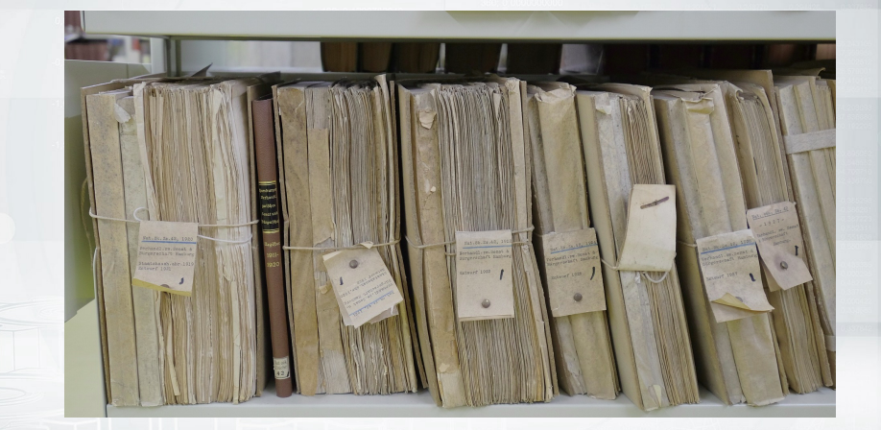
Where do we need that?
Exploration and navigation through large text collections
Notes:
Where do we need this kind of models in real life?
Well actually everywhere because everywhere you have big collections of documents.
It can be some news flows or some social media messages or maybe
some data for your domain like for example papers,
research papers that you do not want to read but you want to know
that there are some papers about these and that and they are connected this way.
So, you want some nice overview of
the area to build this automatically and topic models can do it for you.

Slide 6
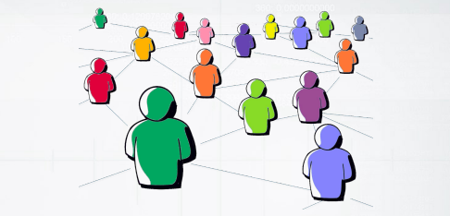

Where do we need that
Social network analysis
Dialogue manager in chat-bots
Notes:
Some other applications would be social network analysis or
even dialog systems because you can imagine that you would generate some text.
You know how to generate text,
right, from the previous week,
but now you can do this text generation dependent on the topics that you want to mention

Slide 7
Why do we need it
Topic models provide hidden semantic representation of texts.
Many more applications:
Categorization and classification of texts
Document segmentation and summarization
News flows aggregation and analysis
Recommender systems
Image captioning
Bioinformatics (genome annotation)
Exploratory search
…
Notes:
there are many many other applications,
for example aggregation of news flows,
when you have some news about politics for example and you
want to say that this topic becomes popular nowadays,
and one other important application that i want to mention is exploratory search,
which means that you want to say this is some document that I am interested in,
could you please find some similar documents and tell me how they are interconnected?

Slide 8
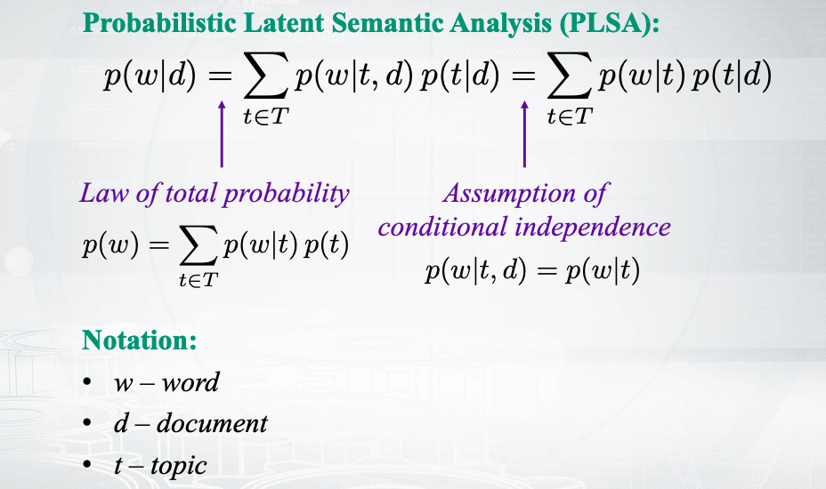
Generative model of texts
Notes:
let us do some math,
so let us discuss probabilistic latent semantic analysis, PLSA.
This is a topic model proposed by Thomas Hofmann in 1999.
This is a very basic model that tries to predict words in
documents and it does so by a mixture of topics.
So, do you understand what happens for the first equation here in this formula?
Well, this is a law of total probability.
So, if you just don't care about documents in the formulas for now,
about D, you can notice that this is the law of total probability applied here.
Now what about the second equation here?
Well, this is not correct,
this is just our assumption.
So, just for simplicity,
we assume that the probability of word
given the topic doesn't depend anymore on the document.
So, this is conditional independence assumption.
This is all that we need to introduce PLSA model.

Slide 9
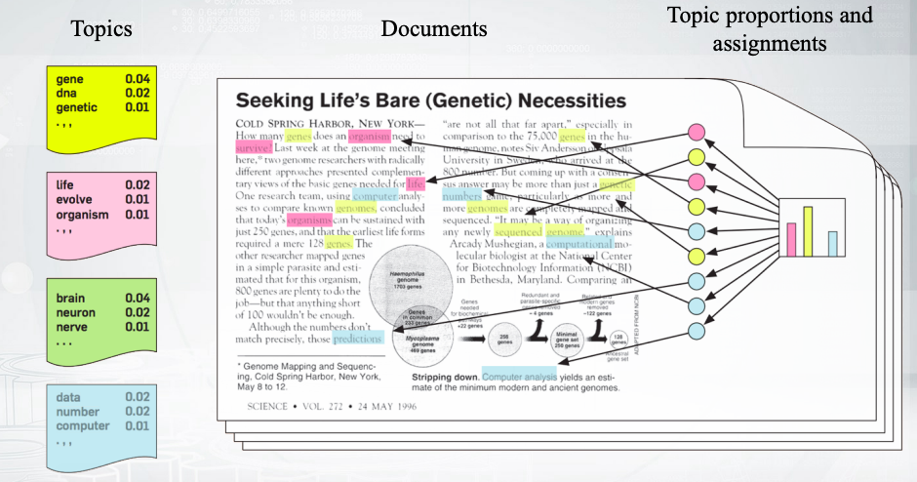
Generative model of texts
Notes:
this is a generative story.
This is a story how the data is generated by our model.
You have some probability distribution of topics for the document and
first you decide what would be the topic for the next word.
Then, once you have decided on that,
you can draw a certain word from the probability distribution for this topic.
So, this model just assumes that the text is generated not by authors,
not just by handwriting,
but by some probability procedure.
So, first we toss a coin and decide what topic will be next,
and then we toss a coin again and decide what would be the exact word,
and we go on through the whole text.
Well, this is just one way to think about it

Slide 10
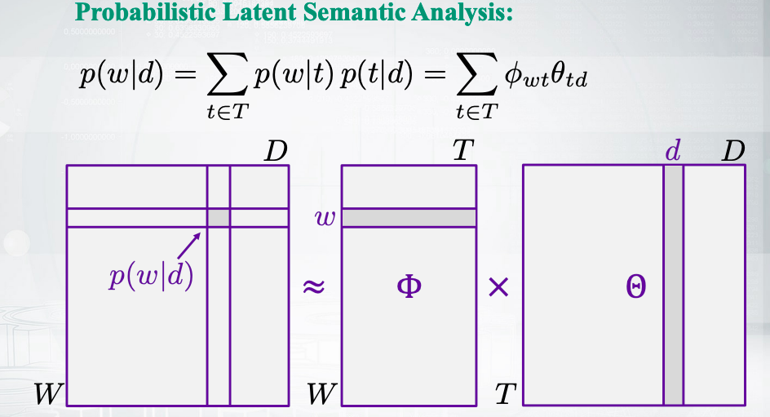
Matrix way of thinking
Notes:
this is a matrix way of thinking about this same model.
You can imagine that you have some data which is just word document co-occurrences.
So, you know how many times each word occurs in each document.
That's why you can compute distributions.
You can compute probabilities of words in documents.
You just normalize those counts and that's it.
Now you need to factorize this real matrix
into two matrices of your parameters, Phi and Theta.
One matrix, Phi matrix,
is about probability distributions over words and
Theta matrix contains probability distributions over topics.
Actually every column in this matrix is a probability distribution.
So, this is just a matrix form of the same formula in the top of the slide,
and you can see that it holds just for one element and for any element obviously

Slide 11
Topic modeling
How to train plsa
Notes:
Let us understand how to train PLSA model.

Slide 12

How would you train the model?
Probabilistic latent semantic analysis:
$p\left(w | d\right)=\sum_{t∈T}{p\left(w | t\right)p\left(t | d\right)=\sum_{t∈T}{φ_{wt}}θ_{td}}$
Parameters of the model:
$φ_{wt}$ - probability of word w in topic t
$θ_{td}$ - probability of topic t in document d
Notes:
So, just to recap,
this is a topic model that predicts words in documents by a mixture of topics.
So we have some parameters in this model.
We have two kinds of probability distributions,
phi parameters stand for probabilities of words and topics,
and theta parameters stand for probabilities of topics and documents.
Now, you have your probabilistic model of data,
and you have your data.
How do you train your models?
So, how do you estimate the parameters?
Likelihood maximization is something that always help us

Slide 13

How would you train the model?
Log-likelihood optimization:
$log\prod_{d∈D}{p(d})\prod_{w∈d}{{p(w|d)}^{n_{wd}}}→\max_{Φ,Ξ}{ }$
$\sum_{d∈D}{\sum_{w∈d}{n_{dw}}\log{\sum_{t∈T}{∅_{wt}θ_{td}}}→}$ $\max_{Φ,Ξ}$
Given non-negativity and normalization constraints:
$∅_{wt}≥0$ $\sum_{w∈W}{∅_{wt}}=1$ $\sum_{t∈T}{θ_{td}=1}$
$θ_{td}≥0$
Notes:
the top line for this slide is the log-likelihood of our model,
and we need to maximize this with the respect to our parameters.
Now, let us do some modification in this formula.
So first, let us apply logarithm,
and we will have the sum of logarithms instead of the logarithm of the products.
Then, let us just get rid of the probability of the document because
the probability of the document does not depend on our parameters,
which they do not even know how to model this pairs.
So we just forget about them.
What we care about is the probabilities of words in documents.
So we substitute them by the sum of our topics.
So this is what our model says.
Great. So that's it.
And we want to maximize this likelihood,
and we need to remember about constraints.
So our parameters are probabilities.
That's why they need to be non-negative,
and they need to be a normalized.
Now, you can notice that this term that we need to maximize is not very nice.
We have a logarithms for the sum,
and this is something ugly that is not really clear how to maximize.
But fortunately, we have EM-algorithm,
you could hear about this algorithm in other course in our Specialization.
But now, I want just to come to this algorithm intuitively.
So let us start with some data

Slide 14
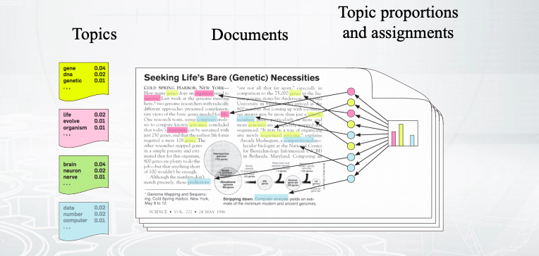
We have just plain texts
Pooh rubbed his nose again, and said that he hadn't thought of that. And then he brightened again, and said that, if it were raining already, the Heffalump would be looking at the sky wondering if it would clear up, and so he wouldn't see the Very Deep Pit until he was half-way down…
Notes:
So we are going to train our model on plain text.
So this is everything of what we have.
Now, let us remember that we know the generative model.
So we assume that every word in this text has
some one topic that was generated when we decided to reach what will be next.
So let us pretend, just for a moment,
just for one slide,
that we know these topics

Slide 15

If we knew topic assignments…
Pooh rubbed his nose again, and said that he hadn't thought of that. And then he brightened again, and said that, if it were raining already, the Heffalump would be looking at the sky wondering if it would clear up, and so he wouldn't see the Very Deep Pit until he was half-way down…
We would just count:
$p\left(w=sky | t\right)=\frac{n_{wt}}{\sum_{w}{w_{wt}}}=\frac{1}{4}$
$p\left(t=t | d\right)=\frac{n_{td}}{\sum_{t}{n_{td}}}=\frac{4}{54}$
Notes:
So let us pretend that we know that the words sky, raining,
and clear up go from sub topic number 22, and that's it.
So we know these assignments.
How would you then calculate the probabilities of words in topics?
So you know you have four words for this topic,
and you want to calculate the probability of sky, let's say.
This is how you do it.
You just say, "Well,
I like one word out of these four words.
So the probability will be one divided by four."
By NWT here, I denote the count of
how many times this certain word was connected to this certain topic.
So, can you imagine how would we evaluate the probability of
topics in this document for this colorful case.
Well, it's just the same.
So we know that we have four words about this red topic,
and we have 54 words in our document,
that's why we have this probability for this example

Slide 16

But we have just plain texts
Pooh rubbed his nose again, and said that he hadn't thought of that. And then he brightened again, and said that, if it were raining already, the Heffalump would be looking at the sky wondering if it would clear up, and so he wouldn't see the Very Deep Pit until he was half-way down…
Idea! Let’s estimate the topic assignment probabilities!
$p\left(t | d,w\right)=\frac{p(w,t|d)}{p(w|d)}=\frac{p\left(w | t\right)p(t|d)}{p(w|d)}$
Bayes rule. Product rule
Notes:
Well, unfortunately, life is not like this.
We do not know this colorful topic assignments.
What we have is just plain text. And that's a problem.
But, can we somehow estimate those assignments?
Can we somehow estimate the probabilities of the colors for every word?
Yes we can. So, Bayes rule helps us here.
What we can do, we can say that we need probabilities of topics for each word
in each document and apply Bayes rule and product rule.
So, to understand this,
I just advise you to forget about D in all this formulas,
and then everything will be very clear.
So we just apply these two rules,
and we get some estimates for probabilities of
our hidden variables, probabilities of topics

Slide 17

Put everything together: EM-algorithm
E-step:
$p\left(t | d,w\right)=\frac{p\left(w | t\right)p(t|d)}{p(w|d)}=\frac{∅_{wt}θ_{td}}{\sum_{s∈T}{∅_{ws}θ_{sd}}}$
M-step:
$∅_{wt}=\frac{n_{wt}}{\sum_{w}{n_{wt}}}$ $n_{wt}=\sum_{d}{n_{dw}p(t|d,w)}$
$θ_{td}=\frac{n_{td}}{\sum_{t}{n_{td}}}$ ${ n}_{td}=\sum_{w}{n_{dw}p(t|d,w)}$
Notes:
Now, it's time to put everything together.
So, we have EM-algorithm which has two steps, E-step and M-step.
Each step is about estimating the probabilities of hidden variables,
and this is what we have just discussed.
M-step is about those updates for parameters.
So we have discussed it for the simple case when we know the topics assignment exactly.
Now, we do not know them exactly.
So, it is a bit more complicated to compute NWT counts.
This is not just how many times the word is connected with this topic,
but it's still doable.
So, we just take the words,
we take the counts of the words,
and we weight them with the probabilities that we know from the E-step.
And that's how we get some estimates for NWT.
So this is not int counter anymore.
It has some flow to variable that still has the same meaning,
still has the same intuition.
So, the EM-algorithm is a super powerful technique,
and it can be used any time when you have your model,
you have your observable data,
and you have some hidden variables.
So, this is all formulas that we need for now.
You just want to understand that to build your topic model,
you need to repeat those E-step and M-step iteratively.
So, you scan your data,
you compute probabilities of topics using your current parameters,
then you update parameters using
your current probabilities of topics and you repeat this again and again.
And this iterative process converge and hopefully,
you will get your nice topic model trained.

Slide 18
Topic model
The zoo of topic model
Notes:
You know the basic topic model which is called PLSA,
and now you know how to train it.
Now, what are some other topic models in this world?
What are some other applications that we can solve with the topic modeling?

Slide 19
Martha Ballard’s diary
Diary had daily entries over the course of 27 years
Topic modeling helps to analyze it
Revealed topics (the most probable words):
GARDENING: garden worked clear beans corn warm planted matters cucumbers potatoes plants
CHURCH: meeting attended afternoon reverend worship foren mr famely st lecture discoarst administered
DEATH: day yesterday informed morn years death ye hear expired expired weak dead
SHOPPING: butter sugar carried candles wheat store flower
Notes:
I want to start with a nice application.
It is about diary of Martha Ballard.
So, this is a big diary.
She was writing for 27 years.
This is why it's rather complicated for people to read this diary and to analyze this.
So, some other people decided to apply topic modeling to
this and see what other topics revealed in this diary.
These are some examples of the topics and you can see just the top most probable words.
So, you remember you have your Phi metrics which
stand for probabilities of words and topics.
And this is exactly those words with the highest probabilities.
And actually you can see that the topics are rather intuitively interpretable.
So, there is something about the gardens,
and potatoes, and work in these gardens.
There is something about shopping like sugar,
or flour, or something else.
So, you can look through these top words,
and you can name the topics, and that's nice

Slide 20
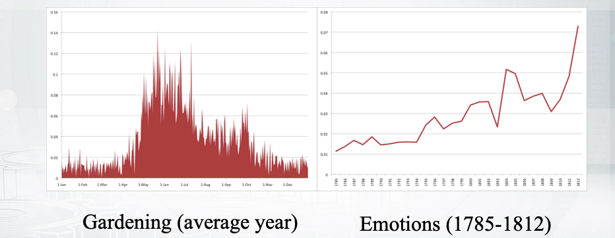
Martha Ballard’s diary
Diary had daily entries over the course of 27 years
Topic modeling helps to analyze it
How topics are developing through time:
Notes:
What's nicer, you can look into how these topics change over time.
So, for example the gardening topic is very popular during summer,
in her diary, and it's not very popular during winter,
and it makes perfect sense.
Right? Another topic which is about emotions has
some high probabilities during
those periods of her life when she had some emotional events.
For example, one moment of high probability there
corresponds to the moment when she got her husband into prison,
and somebody else died,
and something else happened.
So, the historians can I say that,
''OK, this is interpretable.
We understand why this topic has high probability there.''
Now, to feel flexible and to apply your topics in many applications,
we need to do a little bit more math

Slide 21

Latent Dirichlet Allocation
Dirichlet priors for $∅_{t}={\left(∅_{wt}\right)}_{w∈W}$ and $θ_{t}={\left(θ_{td}\right)}_{t∈T}$
$Dir\left(∅_{t} | β\right)=\frac{Γ\left(β_{0}\right)}{\prod_{w}{Γ\left(β_{w}\right)}}\prod_{w}{∅_{wt}^{β_{w}−1}}$. $β_{0}=\sum_{w}{β_{w},β_{t}>0}$
Inference:
Variational Bayes
Gibbs Sampling
Output:
Posterior probabilities for parameters (also Dirichlet!).
Notes:
first, this is the model called Latent Dirichlet Allocation,
and I guess this is the most popular topic model ever.
So, it was proposed in 2003 by David Blei,
and actually any paper about topic models now cite this work.
But, you know this is not very different from PLSA model.
So, everything that it says is that,
''OK we will still have Phi and Theta parameters,
but we are going to have Dirichlet priors for them.''
So, Dirichlet distribution has rather ugly form and you do not need to memorize this,
you can just always Google it.
But, important thing here is that we say that our parameters are not just fixed values,
they have some distribution.
That's why as the output of our model,
we are also going to have some distribution over parameters.
So, not just two matrices of values,
but distribution over them,
and this will be called posterior distribution and it will be
also Dirichlet but with some other hyperparameters

Slide 22
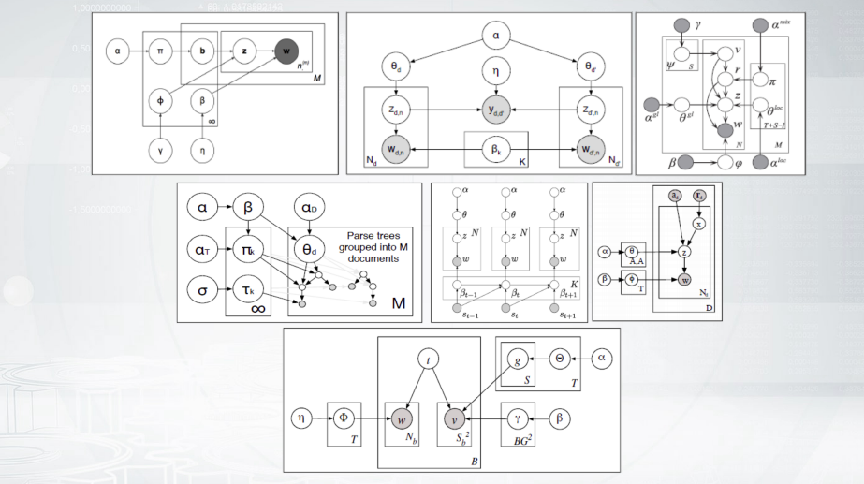
Bayesian methods and graphical models
Notes:
usually people use probabilistic graphical models and
Bayesian inference to provide new topic models and they say,
''OK, we will have more parameters,
we will have more priors.
They will be connected to this and that way.''
So people draw this nice pictures about what happens in the models.
And again, let us not go into
the math details but instead let us look how these models can be applied

Slide 23
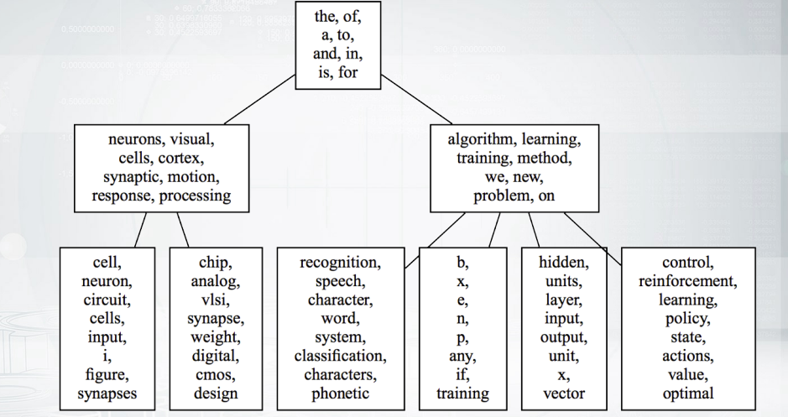
Hierarchical topic models
Notes:
one extension of LDA model would be Hierarchical topic model.
So, you can imagine that you want your topics to build some hierarchy.
For example, the topic about speech recognition would be
a subtopic for the topic about algorithms.
And you see that the root topic has
some very general Lexis and this is actually not surprising.
So, unfortunately, general Lexis is always something that we see with high probabilities,
especially for root topics.
And in some models,
you can try to distill your topics and to say well maybe we should have
some separate topics about
the stop words and we don't want to see them in our main topics,
so we can also play with it.

Slide 24
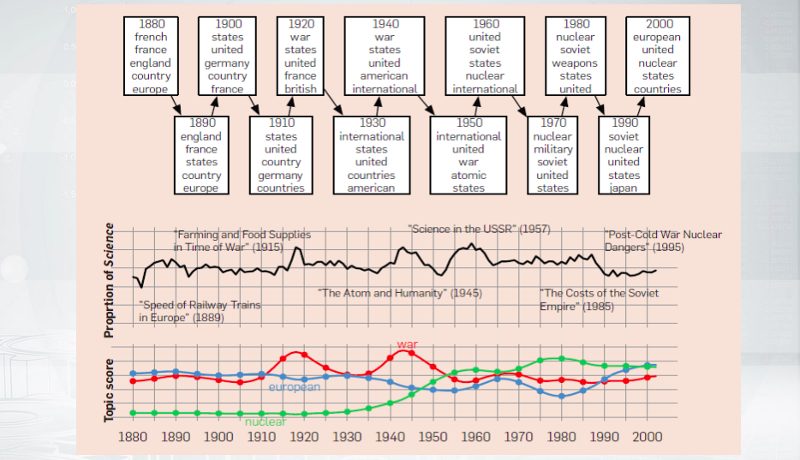
Dynamic topic models
Notes:
another important extension of topic models is Dynamic topic models.
So, these are models that say that topics can evolve over time.
So, you have some keywords for the topic in one year and they change for the other year.

Slide 25
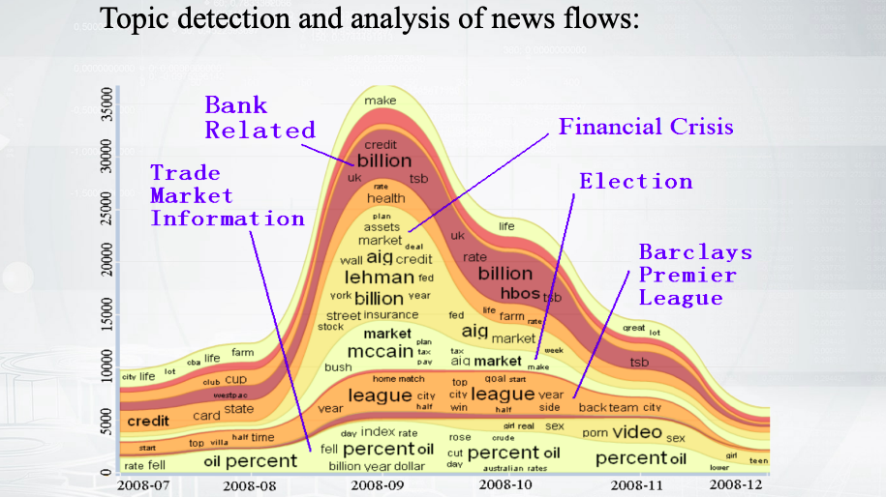
Dynamic topic models
Notes:
Or you can see how the probability of the topics changes.
For example, you have some news flow and you know that some topic about
bank-related stuff is super popular in this month but not that popular later

Slide 26
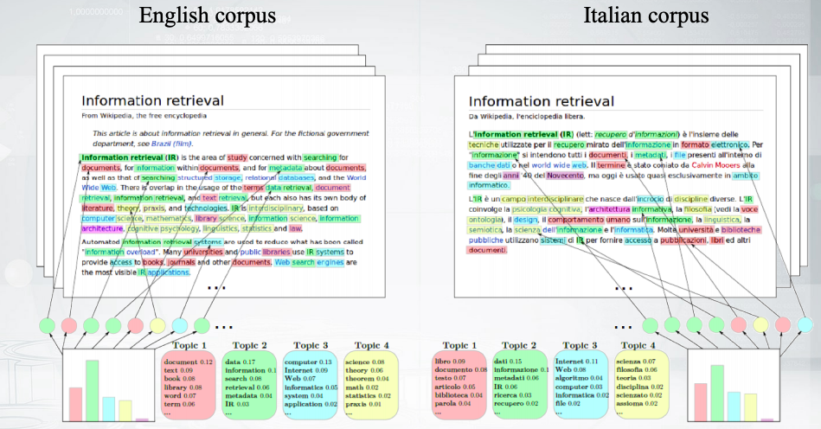
Multilingual topic models
Notes:
One more extension, multilingual topic models.
So, topic is something that is not really dependent on
the language because mathematics exists everywhere, right?
So, we can just express it with different terms in English,
in Italian, in Russian,
and in any other language.
And this model captures this intuition.
So, we have some topics that are just the same
for every language but they are expressed with different terms.
You usually train this model on parallel data so you have
two Wikipedia articles for the same topic,
or let's better say for the same particular concept,
and you know that the topics of these articles should be similar,
but expressed with different terms

Slide 27

Additive Regularization for Topic Models
How to combine all those extensions in one model?
PLSA: $ℒ=\sum_{d∈D}{\sum_{w∈W}{n_{dw}}log\sum_{t∈T}{∅_{wt}θ_{td}}→\max_{Φ,Ξ}{ }}$
ARTM: $ℒ+\sum_{i=1}^{n}{𝒯_{i}R_{i}\left(Φ,θ\right)→}$ $\max_{Φ,Ξ}$
Example of a regularize – diversity of topics:
$R_{i}\left(Φ\right)=−\sum_{t≠s}{\sum_{w}{∅_{wt}∅_{ws}}}$
Notes:
So, we have covered some extensions of Topic Models,
and believe me there are much more in the literature.
So, one natural question that you might have now if whether there
is a way to combine all those requirements into one topic model.
And there might be different approaches here and one approach which we
develop here in our NLP Lab is called Additive Regularization for Topic Models.
The idea is super simple.
So, we have some likelihood for PLSA model.
Now, let us have some additional regularizers.
Let us add them to the likelihood with some coefficients.
So, all we need is to formalize our requirements with some regularizers,
and then tune those tau coefficients to say that, for example,
we need better hierarchy rather than better dynamics In the model.
So, just to provide one example of how those regularizers can look like,
we can imagine that we need different topics in our model,
so it would be great to have as different topics as possible.
To do this, we can try to maximize the negative pairwise correlations between the topics.
So, this is exactly what is written down in the bottom formula.
You have your pairs of topics and you try to make them as different as possible

Slide 28

Regularized EM-algorithm
E-step:
$p\left(t | d,w\right)=\frac{p\left(w | t\right)p(t|d)}{p(w|d)}=\frac{∅_{wt}θ_{td}}{\sum_{s∈T}{∅_{ws}θ_{sd}}}$
M-step:
$∅_{wt}={}_{w∈W}^{norm}{\left(\sum_{d∈D}{n_{dw}}p\left(t | d,w\right)+∅_{wt}\frac{∂R}{∂∅_{wt}}\right)}$
$θ_{td}={}_{w∈W}^{norm}{\left(\sum_{w∈d}{n_{dw}}p\left(t | d,w\right)+∅_{td}\frac{∂R}{∂∅_{td}}\right)}$
Notes:
how can you train this model?
Well, you still can use EM algorithm.
So, the E-step holds the same,
exactly the same as it was for the PLSA topic model.
The M-step changes, but very slightly.
So, the only thing that is new here is green.
This is the derivatives of the regularizers for your parameters.
So, you need to add these terms here to get
maximum likelihood estimations for the parameters for the M-step.
And this is pretty straightforward,
so you just formalize your criteria,
you took the derivatives,
and you could built this into your model

Slide 29
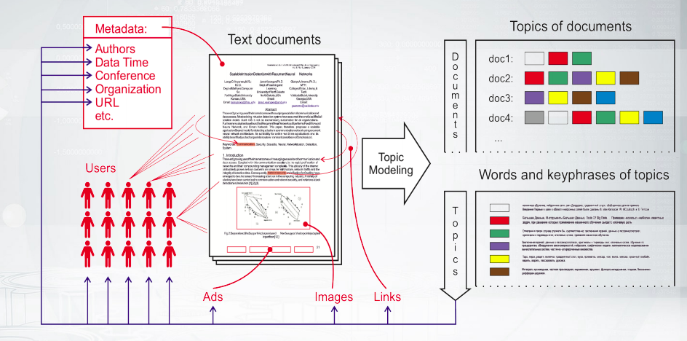
Multimodal topic models
Notes:
Now, I will just show you one more example for this.
So, in many applications we need to model
not only words in the texts but some additional modalities.
What I mean is some metadata,
some users, maybe authors of the papers,
time stamps, and categories,
and many other things that can go with the documents but that are not just words.
Can we build somehow them into our model?

Slide 30

Multi-ARTM
How to incorporate tokens of additional modalities?
PLSA: $ℒ=\sum_{d∈D}{\sum_{w∈W}{n_{dw}}log\sum_{t∈T}{∅_{wt}θ_{td}}→\max_{Φ,Ξ}{ }}$
Multi-ARTM: $\sum_{m∈M}{ℷ_{m}}\sum_{d∈D}{\sum_{w∈W}{n_{dw}}log\sum_{t∈T}{∅_{wt}θ_{td}}→\max_{Φ,Ξ}{ }}$
Each topic is characterized by several probability distributions
More parameters, still trained with EM-algorithm
Notes:
We can actually use absolutely the same intuition.
So, let us just,
instead of one likelihood,
have some weighted likelihoods.
So, let us have a likelihood for every modality and
let us weigh them with some modality coefficients.
Now, what do we have for every modality?
Actually, we have different vocabularies.
So, we treat the tokens of authors modality as a separate vocabulary,
so every topic will be now
not only the distribution of words but the distribution over authors as well.
Or if we have five modalities,
every topic will be represented by five distinct distributions.
One cool thing about multimodal topic models is that you
represent any entities in this hidden space of topics.
So, this is a way somehow to unify all the information in your model.
For example, you can find what are the most probable topics for
words and what are the most probable topics for time stamps, let's say.
And then you can compare some time stamps and words and say,
''What are the most similar words for this day?''
And this is an example that does exactly this

Slide 31
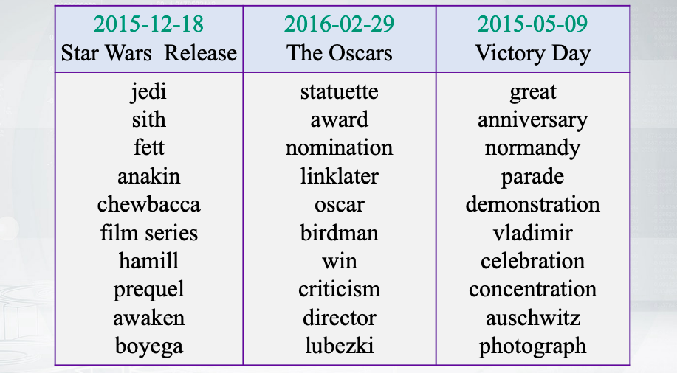
Inter-modality similarities
Notes:
So, we had a corpora that has some time stamps for
the documents and we model the topics both for words and for time stamps,
and we get to know that the closest words for the time stamp,
which corresponds to the Oscars date would be Oscar,
Birdman, and some other words that are really related to this date.
So, once again, this is a way to embed all your different modalities into
one space and somehow find a way to build similarities between them

Slide 32
Libraries for topic modeling
BigARTM is an open-source library for Additive Regularization of Topic Models, bigartm.org
Gensim is a library of text analysis for Python, radimrehurek.com/genism
MALLET is a library of text analysis for Java mallet.cs.umass.edu
Vowpal Wabbit has a fast implementation of online LDA hunch.net/~vw/
Notes:
what would be your actions if you want to build your topic models?
Well, probably you need some libraries.
So, BigARTM library is the implementation of the last approach that I mentioned.
Gensim and MALLET implement online LDA topic model.
Gensim was build for Python and MALLET is built for JAVA.
And Vowpal Wabbit is the implementation of the same online LDA topic model,
but it is known to be super fast.
So, maybe it's also a good idea to check it out

Slide 33
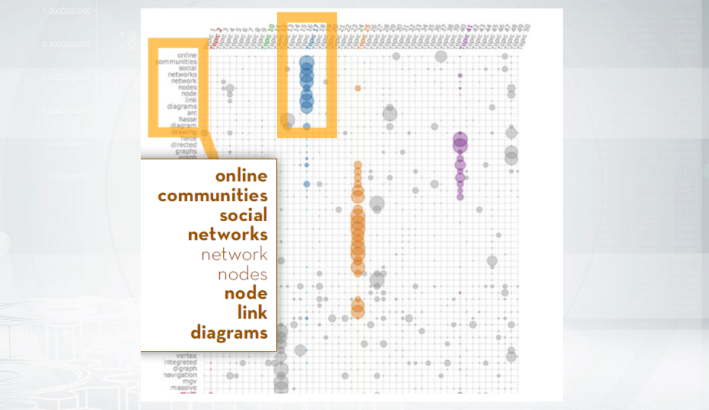
A few words about visualization
Notes:
So you will never get through large collections and that is
not so easy to represent the output of your model,
those probability distributions, in such a way that people can understand that.
So, this is an example how to visualize Phi metrics.
We have words by topic's metrics here and you can see that
we group those words that correspond to every certain topic
together so that we can see that
this blue topic is about
these terms and the other one is about social networks and so on

Slide 34
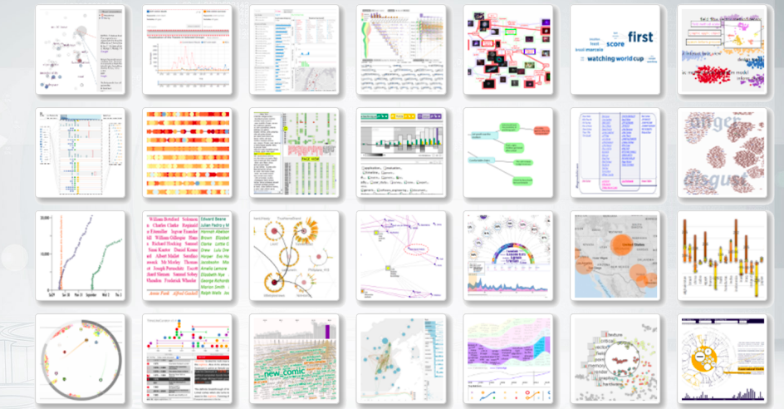
380 ways to visualize: textvis.lnu.se

